Slide 1
APTITUDE
DATA INTERPRETATION
(BAR GRAPH TYPE)
VIDEO-1

Slide 2
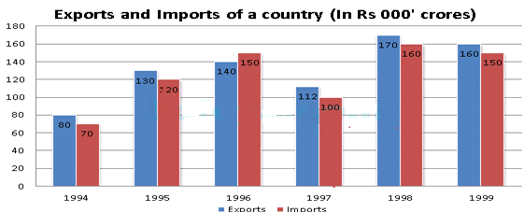
APTITUDE
DATA INTERPRETATION VIDEO-1
Directions (1-3): Study the following graph carefully and answer the questions given below:

Slide 3
APTITUDE
DATA INTERPRETATION VIDEO-1
Q:1. In how many of the given years was the exports at least 10% more than the imports?
(A) 0 (B) 1 (C) 2 (D) 3 (E) 4
Q:2. What was the average exports for the given period (in ‘000 crores)?
145 (B) 132 (C) 126 (D) 119 (E) 138
Q:3. From 1995 to 1999, in which year was the percentage growth In exports, when compared to the previous year, the highest?
1995 (B) 1996 (C) 1997 (D) 1998 (E) 1999

Slide 4
APTITUDE
DATA INTERPRETATION VIDEO-1
Q:1. In how many of the given years was the exports at least 10% more than the imports?
(A) 0 (B) 1 (C) 2 (D) 3 (E) 4
Q:2. What was the average exports for the given period (in ‘000 crores)?
145 (B) 132 (C) 126 (D) 119 (E) 138
Q:3. From 1995 to 1999, in which year was the percentage growth In exports, when compared to the previous year, the highest?
1995 (B) 1996 (C) 1997 (D) 1998 (E) 1999

Slide 5
APTITUDE
THANK YOU

Slide 6
APTITUDE
DATA INTERPRETATION
(BAR GRAPH TYPE)
VIDEO-2

Slide 7
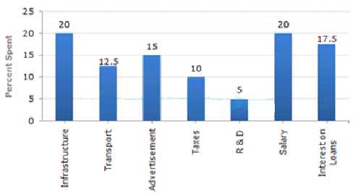
APTITUDE
DATA INTERPRETATION VIDEO-2
Directions (1-5): Study the following graph carefully and answer the questions given below:

Slide 8
APTITUDE
DATA INTERPRETATION VIDEO-2
Q:1. The total amount of expenditures of the company is how many times of expenditure on research and development?
27 B)20 C)18 D) 8
Q:2. If the expenditure on advertisement is 2.10 crores then the difference between the expenditure on transport and taxes is?
Rs. 1.25 crores B) Rs. 95 lakhs C) Rs. 65 lakhs D) Rs. 35 lakhs
Q:3. What is the ratio of the total expenditure on infrastructure and transport to the total expenditure on taxes and interest on loans?
5:4 B) 8:7 C)9:7 D) 13:11
Q:4. If the interest on loans amounted to Rs. 2.45 crores then the total amount of expenditure on advertisement, taxes and research and development is?
Rs. 7 crores B) Rs. 5.4 crores C) Rs. 4.2 crores D) Rs. 3 crores
Q:5. The expenditure on the interest on loans is by what percent more than the expenditure on transport?
5% B)10% C) 20% D) 40%

Slide 9
APTITUDE
DATA INTERPRETATION VIDEO-2
Q:1. The total amount of expenditures of the company is how many times of expenditure on research and development?
27 B)20 C)18 D) 8
Q:2. If the expenditure on advertisement is 2.10 crores then the difference between the expenditure on transport and taxes is?
Rs. 1.25 crores B) Rs. 95 lakhs C) Rs. 65 lakhs D) Rs. 35 lakhs
Q:3. What is the ratio of the total expenditure on infrastructure and transport to the total expenditure on taxes and interest on loans?
5:4 B) 8:7 C)9:7 D) 13:11
Q:4. If the interest on loans amounted to Rs. 2.45 crores then the total amount of expenditure on advertisement, taxes and research and development is?
Rs. 7 crores B) Rs. 5.4 crores C) Rs. 4.2 crores D) Rs. 3 crores
Q:5. The expenditure on the interest on loans is by what percent more than the expenditure on transport?
5% B)10% C) 20% D) 40%

Slide 10
APTITUDE
THANK YOU

Slide 11
APTITUDE
DATA INTERPRETATION
(BAR GRAPH TYPE)
VIDEO-3

Slide 12
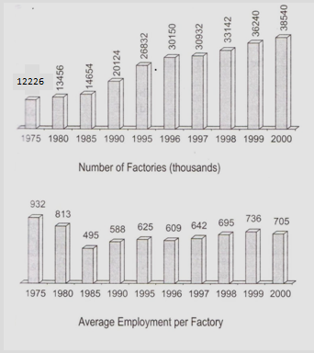
APTITUDE
DATA INTERPRETATION VIDEO-3
DIRECTIONS (1-5) – Study the information given and answer the following questions.

Slide 13
APTITUDE
DATA INTERPRETATION VIDEO-3
Q:1. Between 1995 and 2000, in which year has the average employment per factory shown an increment compared to previous year, but decreased in the next year?
1996 B. 1997 C. 1998 D. 1999 E. None of these
Q:2. If in 1996, 20,100 factories had 659 employments on an average, the remaining factories had an average employment of:
559 B.509 C. 584 D. 534 E. None of these
Q:3.The total employment in 1999 is how many times to that in 1996?
1.45 B. 1.48 C. 1.6 D. 1.42 E. None of these
Q:4.In which of the following five-year period, number of factories has shown maximum increase?
1980-85 B. 1985-90 C. 1990-95 D. 1995-00 E. None of these

Slide 14
APTITUDE
DATA INTERPRETATION VIDEO-3
Q:1. Between 1995 and 2000, in which year has the average employment per factory shown an increment compared to previous year, but decreased in the next year?
1996 B. 1997 C. 1998 D. 1999 E. None of these
Q:2. If in 1996, 20,100 factories had 659 employments on an average, the remaining factories had an average employment of:
559 B.509 C. 584 D. 534 E. None of these
Q:3.The total employment in 1999 is how many times to that in 1996?
1.45 B. 1.48 C. 1.6 D. 1.42 E. None of these
Q:4.In which of the following five-year period, number of factories has shown maximum increase?
1980-85 B. 1985-90 C. 1990-95 D. 1995-00 E. None of these

Slide 15
APTITUDE
THANK YOU

Slide 16
APTITUDE
DATA INTERPRETATION
(BAR GRAPH TYPE)
VIDEO-4

Slide 17
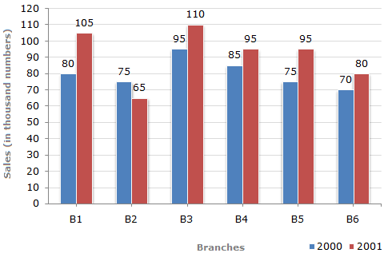
APTITUDE
DATA INTERPRETATION VIDEO-4
Directions to Solve(1--5):The bar graph given below shows the sales of books (in thousand number) from six branches of a publishing company during two consecutive years 2000 and 2001.
Sales of Books (in thousand numbers) from Six Branches - B1, B2, B3, B4, B5 and B6 of a publishing Company in 2000 and 2001.
.

Slide 18
APTITUDE
DATA INTERPRETATION VIDEO-4
Q:1. What is the ratio of the total sales of branch B2 for both years to the total sales of branch B4 for both years?
2:3 B. 3:5 C. 4:5 D. 7:9
Q:2. Total sales of branch B6 for both the years is what percent of the total sales of branches B3 for both the years?
68.54% B. 71.11% C. 73.17% D. 75.55%
Q:3. What percent of the average sales of branches B1, B2 and B3 in 2001 is the average sales of branches B1, B3 and B6 in 2000?
75% B. 77.5% C. 82.5% D. 87.5%
Q:4. What is the average sales of all the branches (in thousand numbers) for the year 2000?
73 B. 80 C. 83 D. 88
Q:5. Total sales of branches B1, B3 and B5 together for both the years (in thousand numbers) is?
A. 250 B. 310 C. 435 D. 560

Slide 19
APTITUDE
DATA INTERPRETATION VIDEO-4
Q:1. What is the ratio of the total sales of branch B2 for both years to the total sales of branch B4 for both years?
2:3 B. 3:5 C. 4:5 D. 7:9
Q:2. Total sales of branch B6 for both the years is what percent of the total sales of branches B3 for both the years?
68.54% B. 71.11% C. 73.17% D. 75.55%
Q:3. What percent of the average sales of branches B1, B2 and B3 in 2001 is the average sales of branches B1, B3 and B6 in 2000?
75% B. 77.5% C. 82.5% D. 87.5%
Q:4. What is the average sales of all the branches (in thousand numbers) for the year 2000?
73 B. 80 C. 83 D. 88
Q:5. Total sales of branches B1, B3 and B5 together for both the years (in thousand numbers) is?
A. 250 B. 310 C. 435 D. 560

Slide 20
APTITUDE
THANK YOU

